Slide 1
Dynamic Programming for Power Systems
Aryan Ritwajeet Jha
Notes:
Remember to hit the reset button to make sure all the page elements react properly.
There are 20 different layouts that you can choose from.

Slide 2
Contents
Problem Formulation of Anamika Dubey and Surya Santoso (2015) Electric Vehicle Charging on Residential Distribution Systems: Impacts and Mitigation. It is a harder dynamic programming problem.
Problem Statements where Dynamic Programming is utilized.
Recursive Fibonacci Sequence with Memoization.
Shortest Path Problem with Memoization.

Slide 3
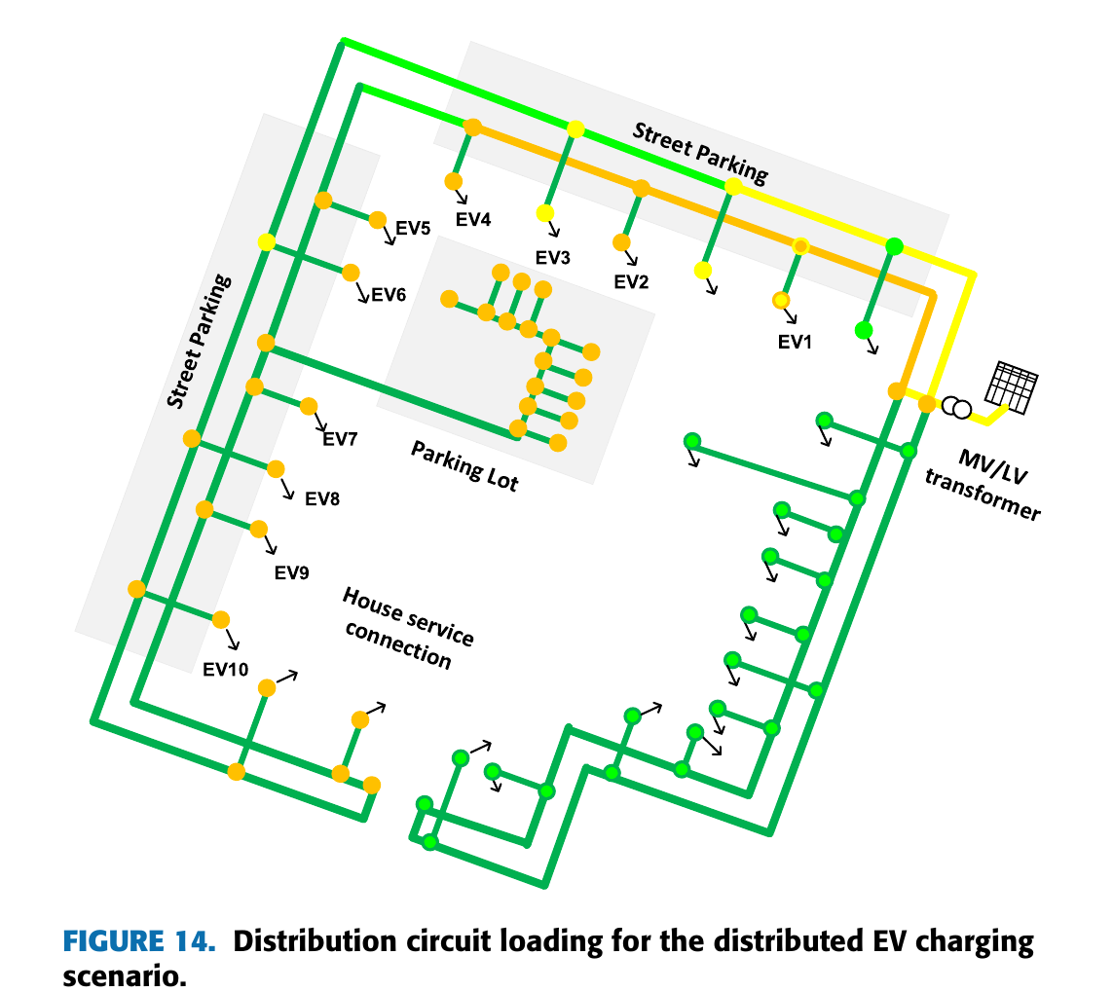
Electric Vehicle Charging on Residential Distribution Systems: Impacts and Mitigation Anamika Dubey and Surya Santoso (2015)
EVs are plugged in during the night for charging.
Charging at multiple locations of the residential grid (a distribution network) at the same time causes voltage drops.
Such uncoordinated power consumption at the local scale can lead to grid problems.

Slide 4
Electric Vehicle Charging on Residential Distribution Systems: Impacts and Mitigation Anamika Dubey and Surya Santoso (2015)
Context:
Charge M vehicles (loads) during night-time from M charging stations (nodes).
Night-time = 6PM to 6AM.
Charge them fully before the next morning.
They aren’t leaving before 6AM, so no hard constraints on the available charging timings themselves.

Slide 5
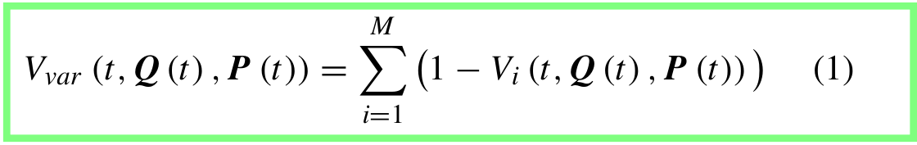
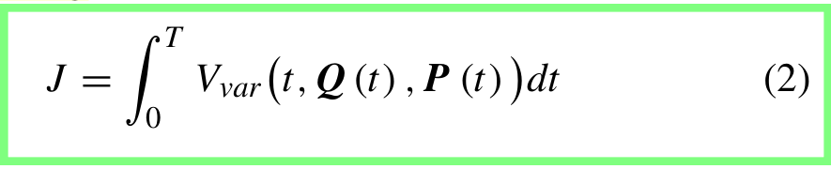

Electric Vehicle Charging on Residential Distribution Systems: Impacts and Mitigation Anamika Dubey and Surya Santoso

Slide 6
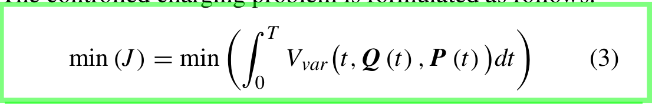
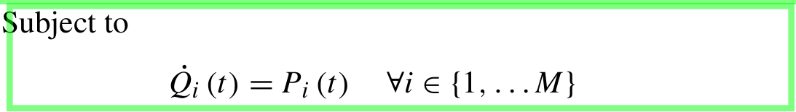
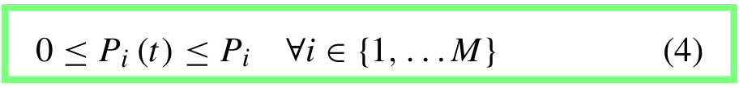
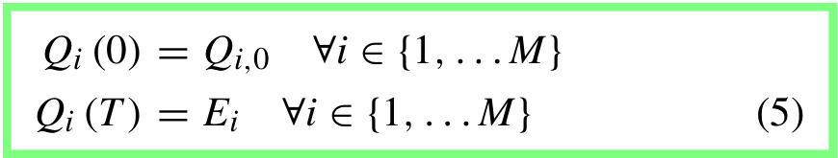
Electric Vehicle Charging on Residential Distribution Systems: Impacts and Mitigation Anamika Dubey and Surya Santoso
Objective:
minimize impact on residential grid voltage, for the whole night.
Design objective (constraint): Charge every EV fully by time T.

Slide 7
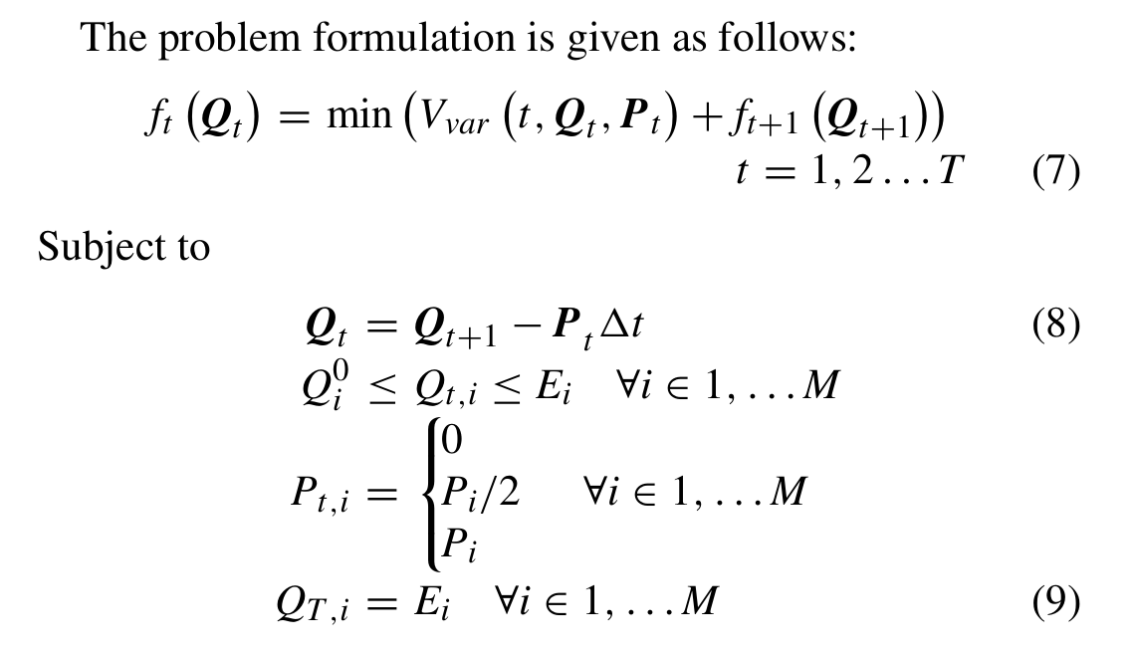
Electric Vehicle Charging on Residential Distribution Systems: Impacts and Mitigation Anamika Dubey and Surya Santoso
Objective:
minimize impact on residential grid voltage, for the whole night.
Design objective (constraint): Charge every EV fully by time T.

Slide 8
Electric Vehicle Charging on Residential Distribution Systems: Impacts and Mitigation Anamika Dubey and Surya Santoso
Design Formulation:
Battery-charger power levels P(t) variable only in discrete-steps. (zero, half-of-max-capacity, max-capacity)
Power-flow-analysis also done in discrete time-steps.
We’re solving a discretized Optimal Control Problem.
This is a ‘harder’ dynamic programming problem because of the boundary constraints.
Dynamic Programming Successive Approximation Method? Need to study it in detail.

Slide 9
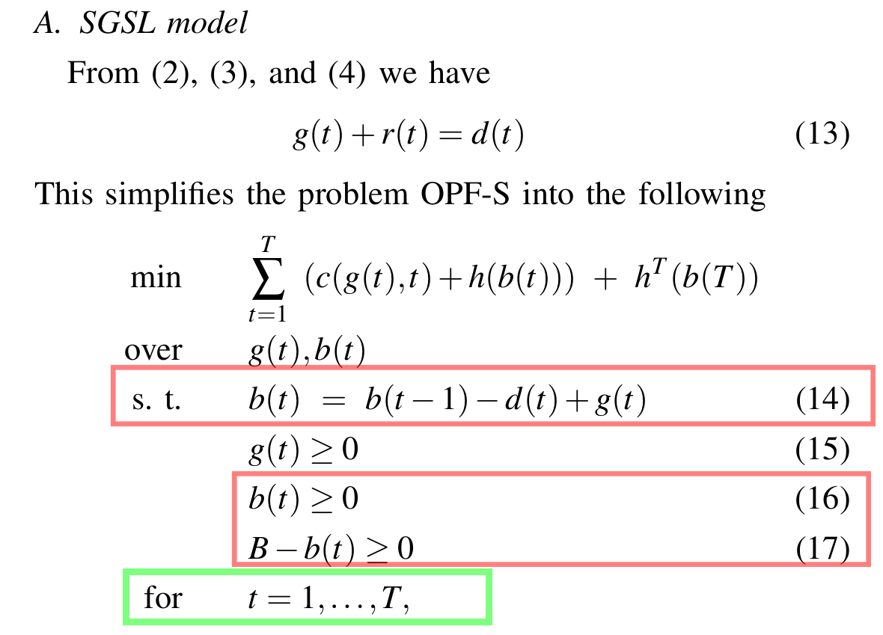
A simple optimal power flow model with energy storage Chandy, Low, Topcu, Xu IEEE Conf. on Decisions and Control 200+ citations
Our objective function is still loss minimization, so different from the one given.

Slide 10
Dynamic Programming
Power System Optimization
Discrete Optimal Control Problem
Multi-time-period optimization work done here.

Slide 11

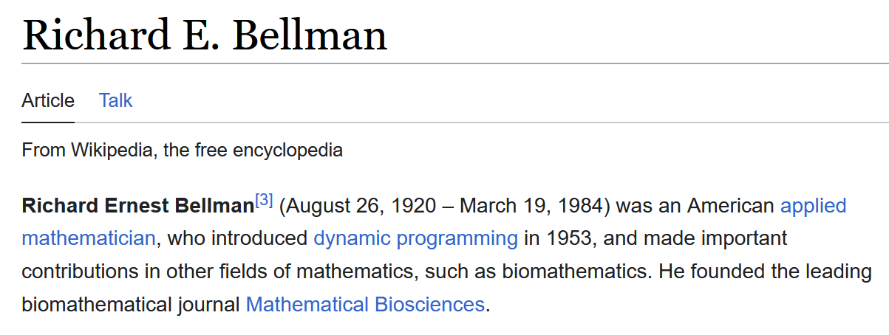
Dynamic Programming
Bellman showed that a dynamic optimization problem in discrete time can be stated in a recursive, step-by-step form known as backward induction by writing down the relationship between the value function in one period and the value function in the next period. The relationship between these two value functions is called the "Bellman equation".

Slide 12
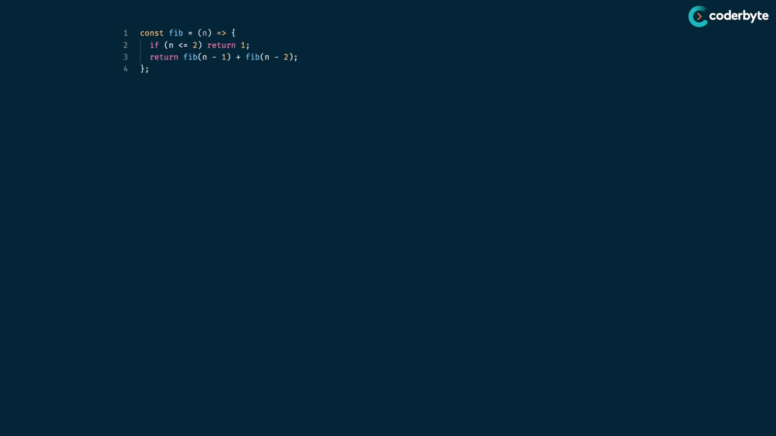
Fibonacci Sequence using Dynamic Programming

Slide 13
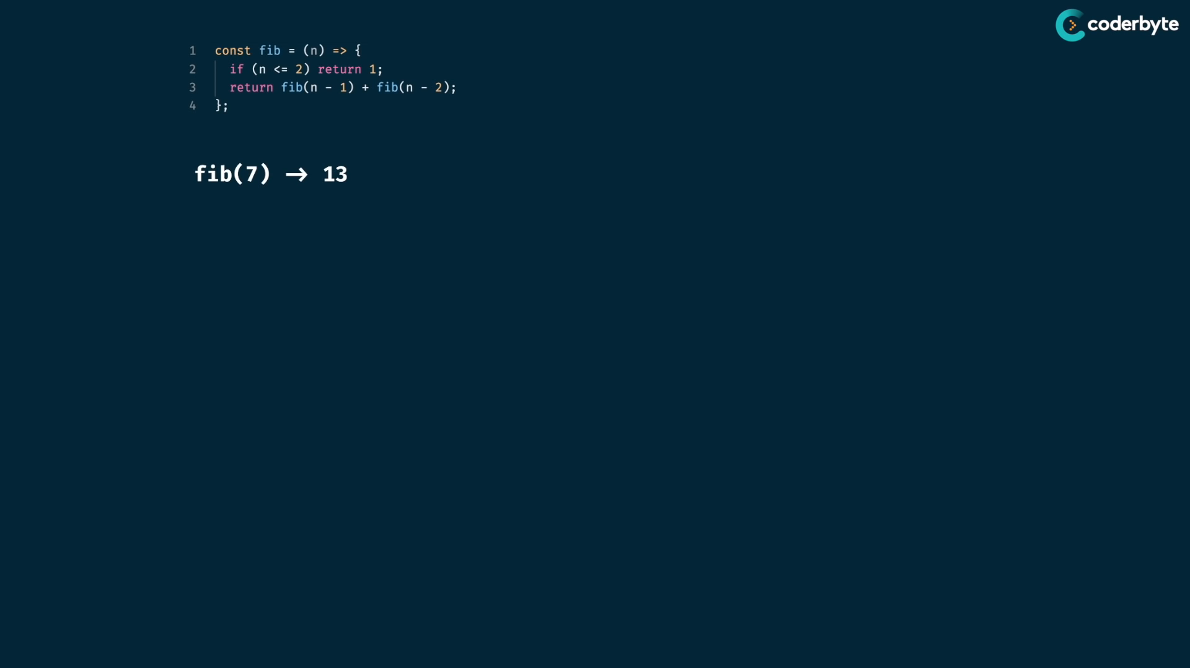

Slide 14
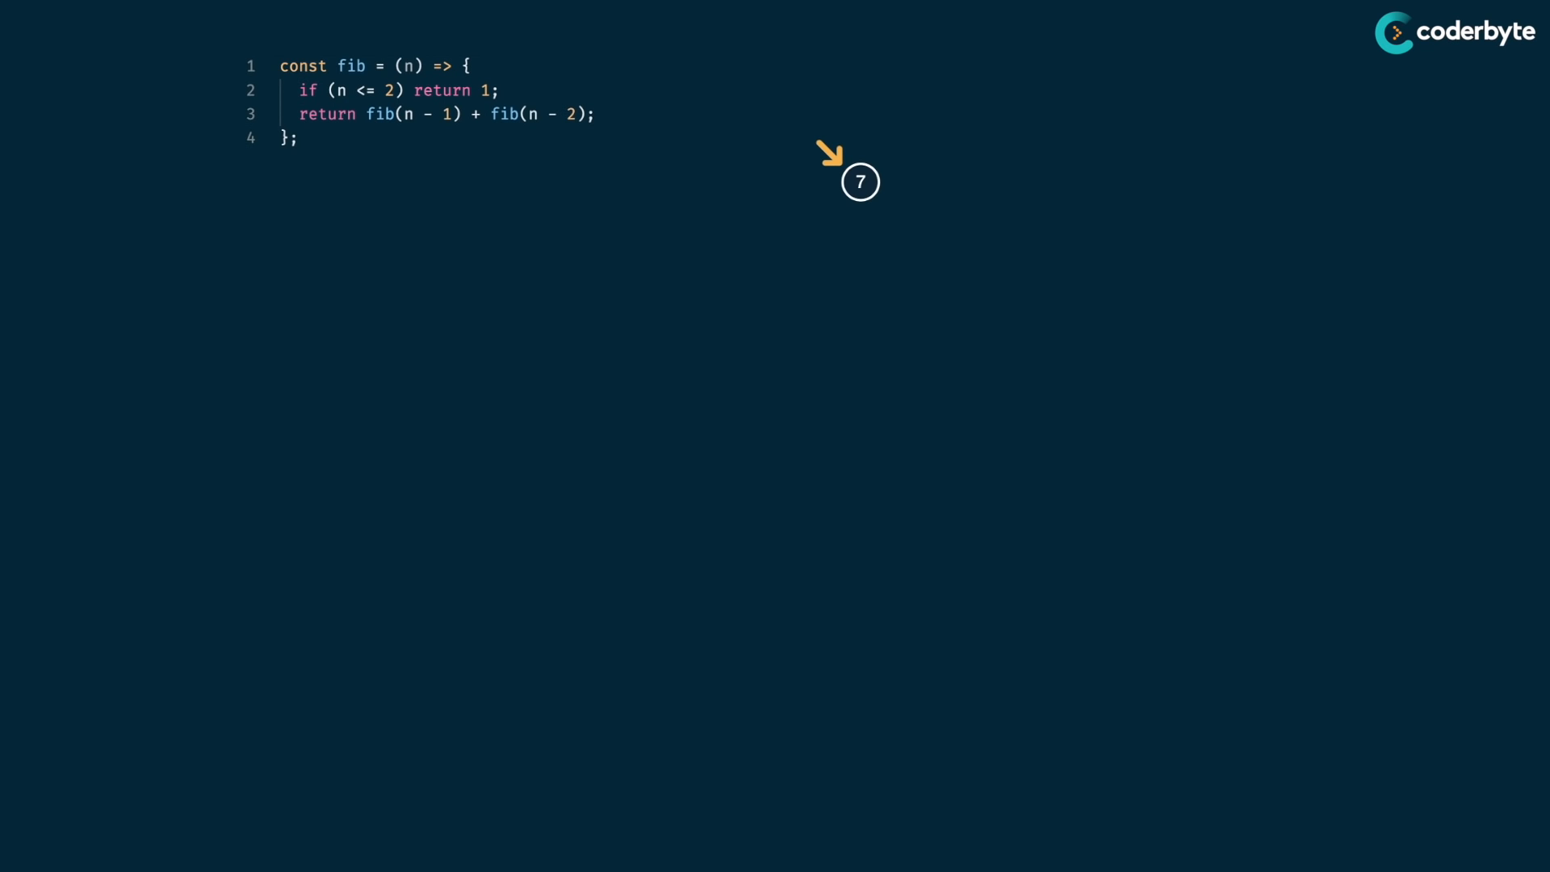

Slide 15
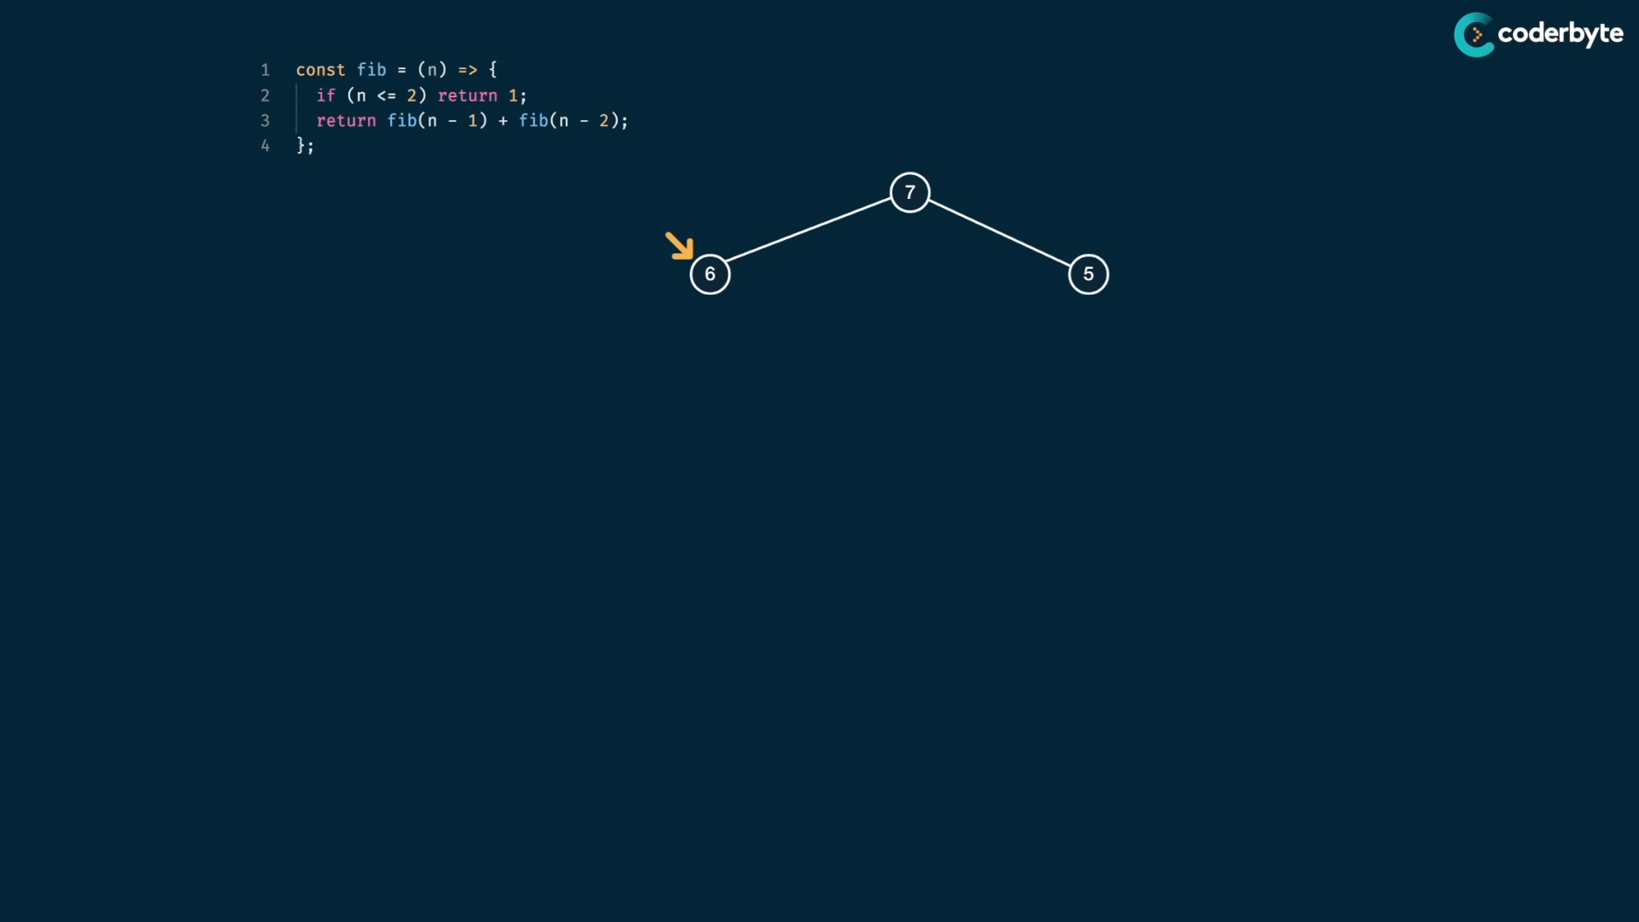

Slide 16
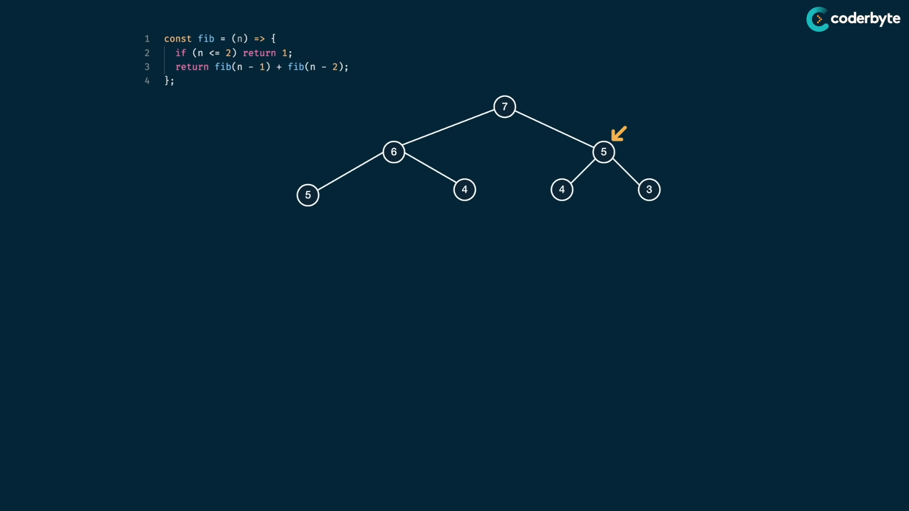

Slide 17
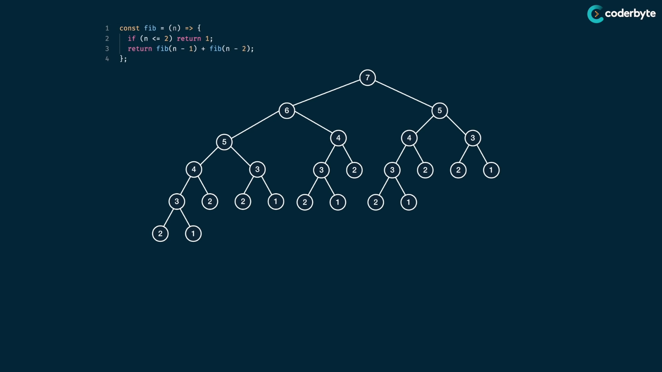

Slide 18
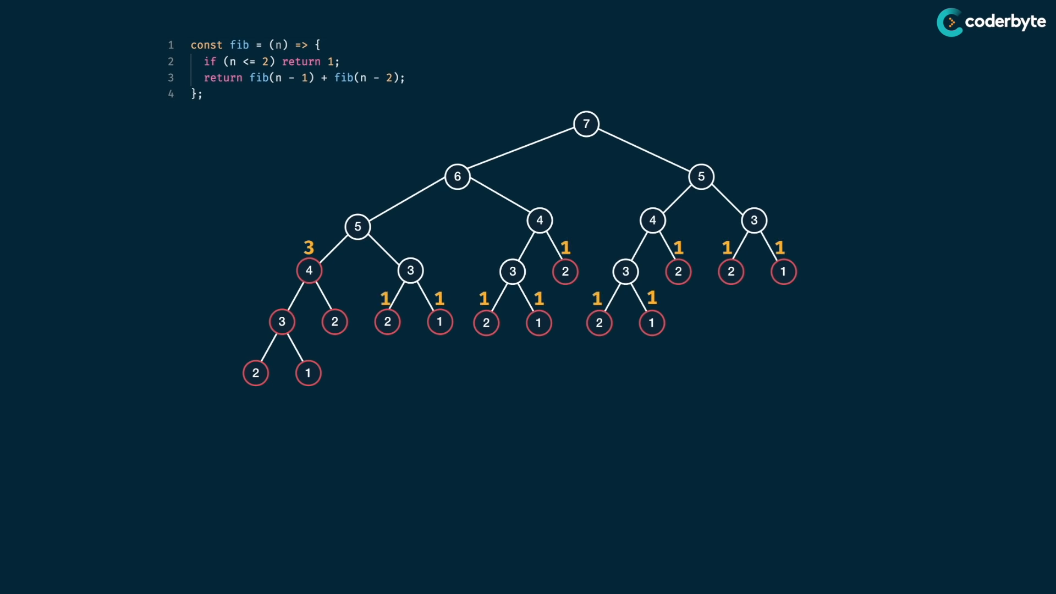

Slide 19
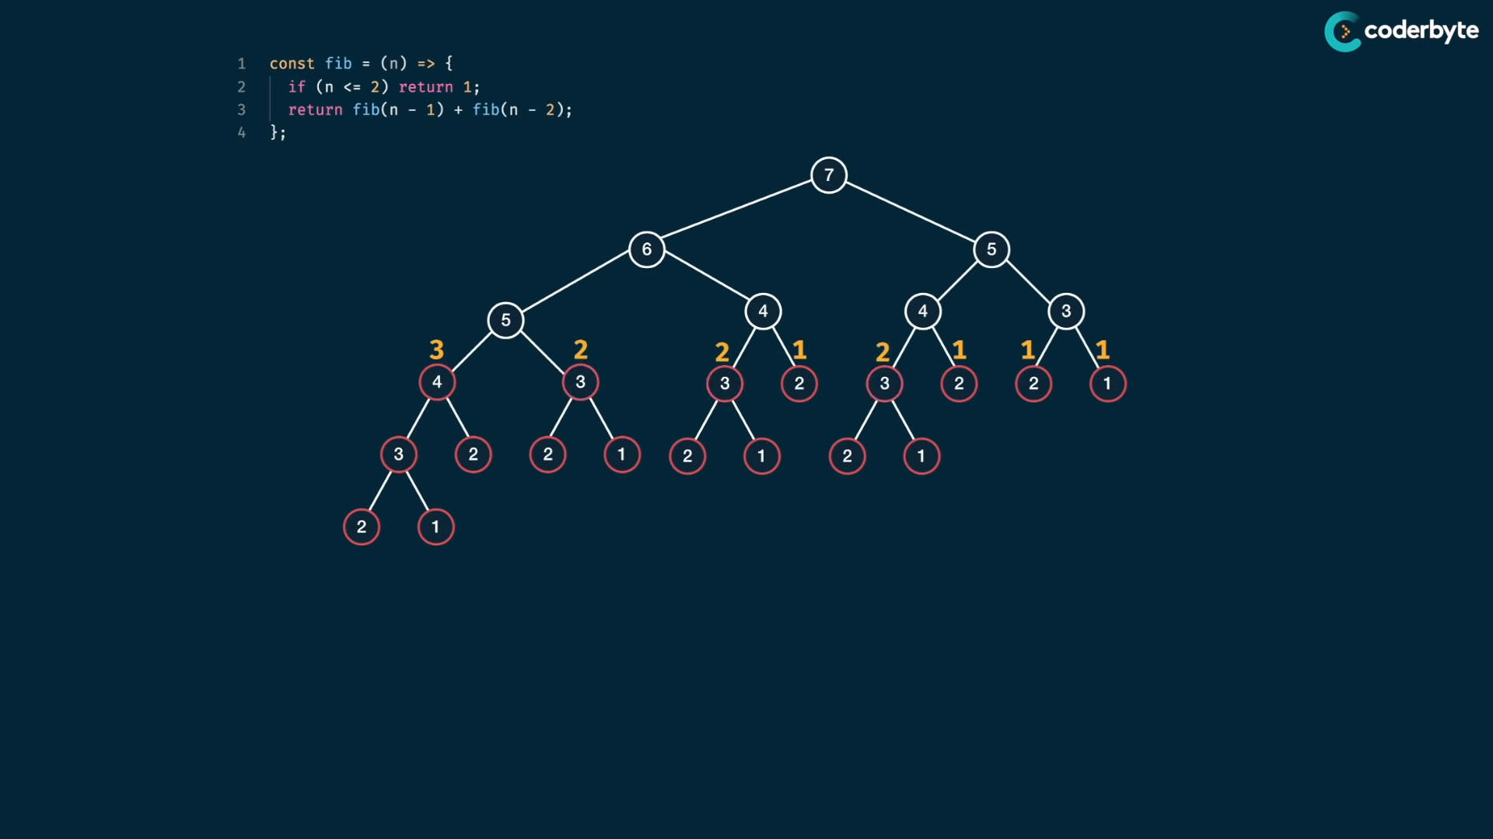

Slide 20
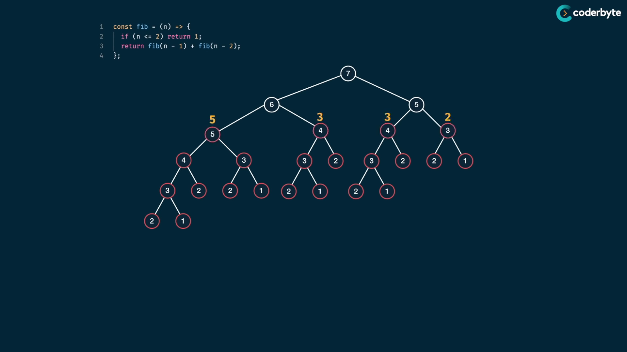

Slide 21
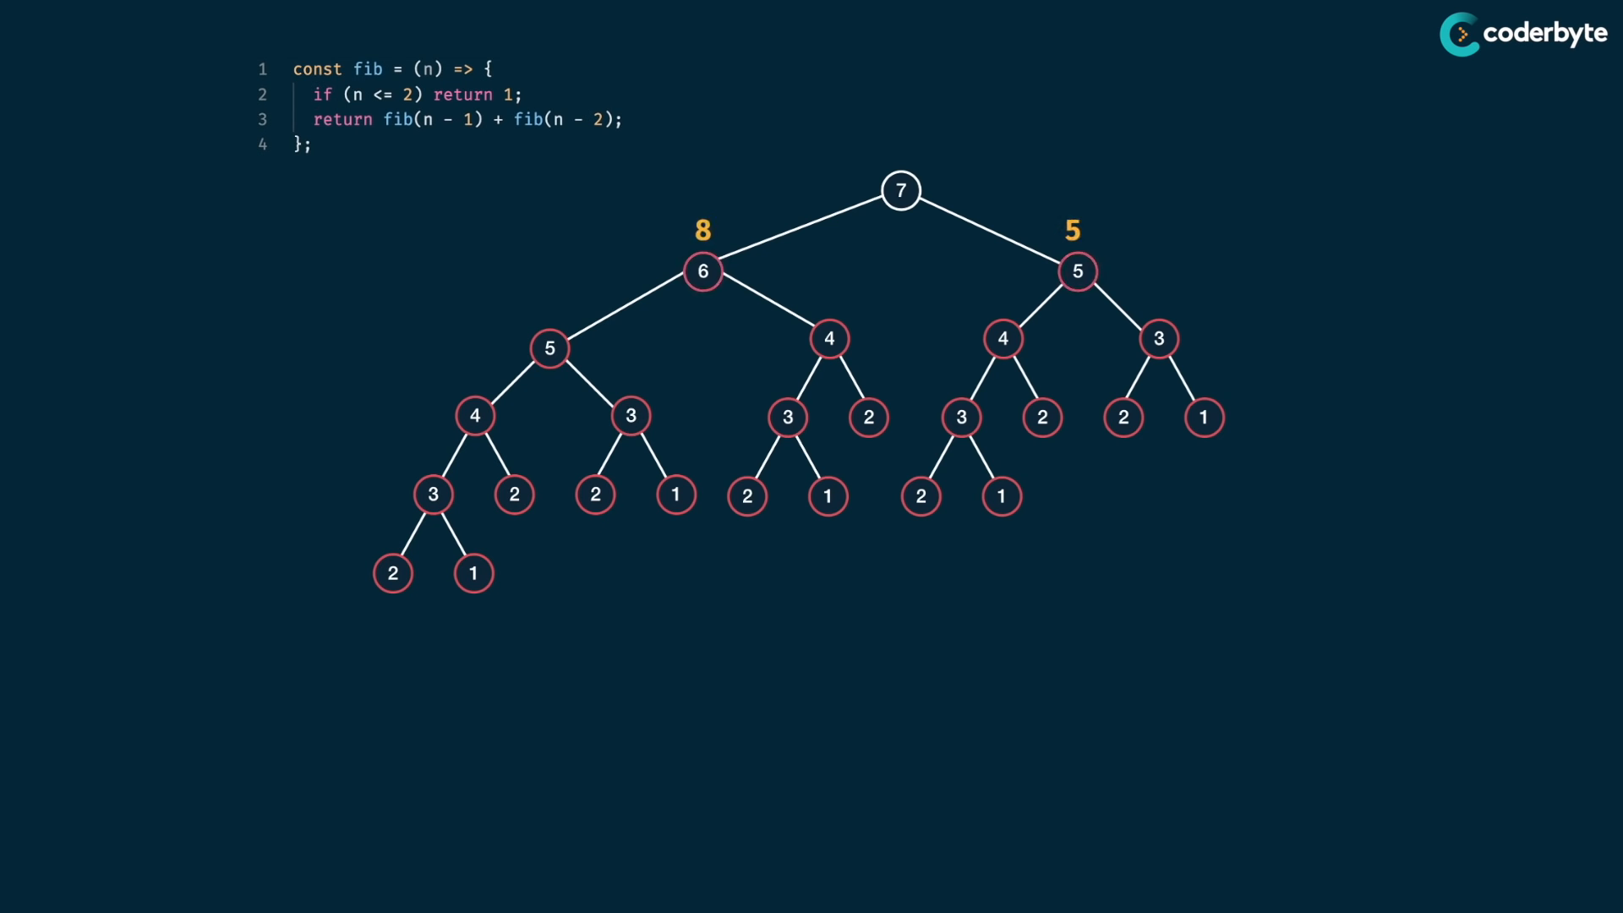

Slide 22
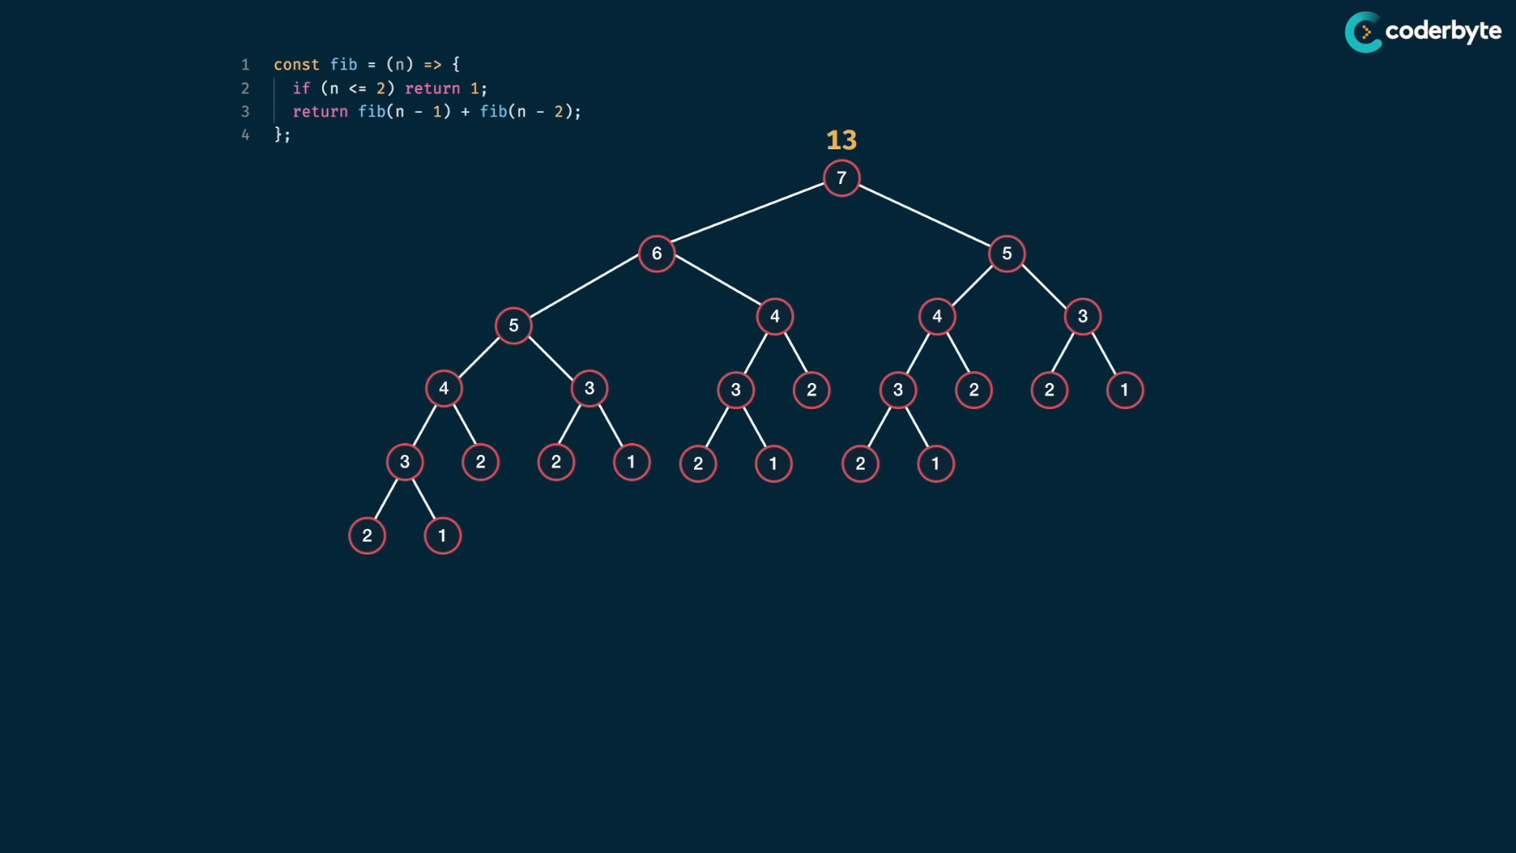

Slide 23
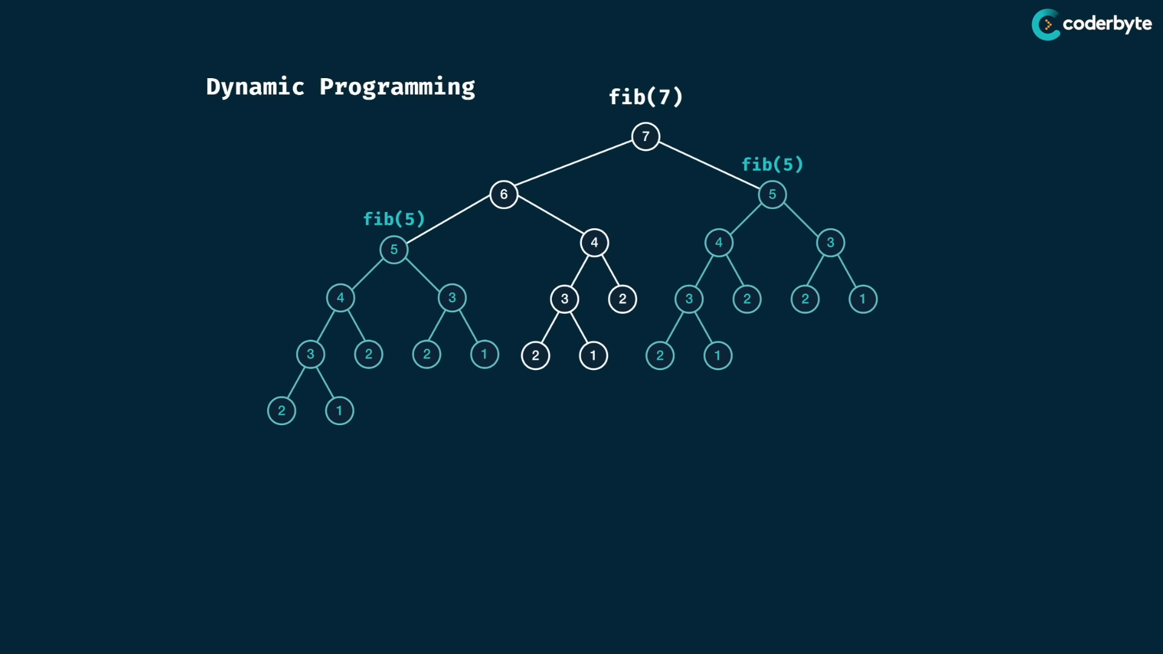

Slide 24
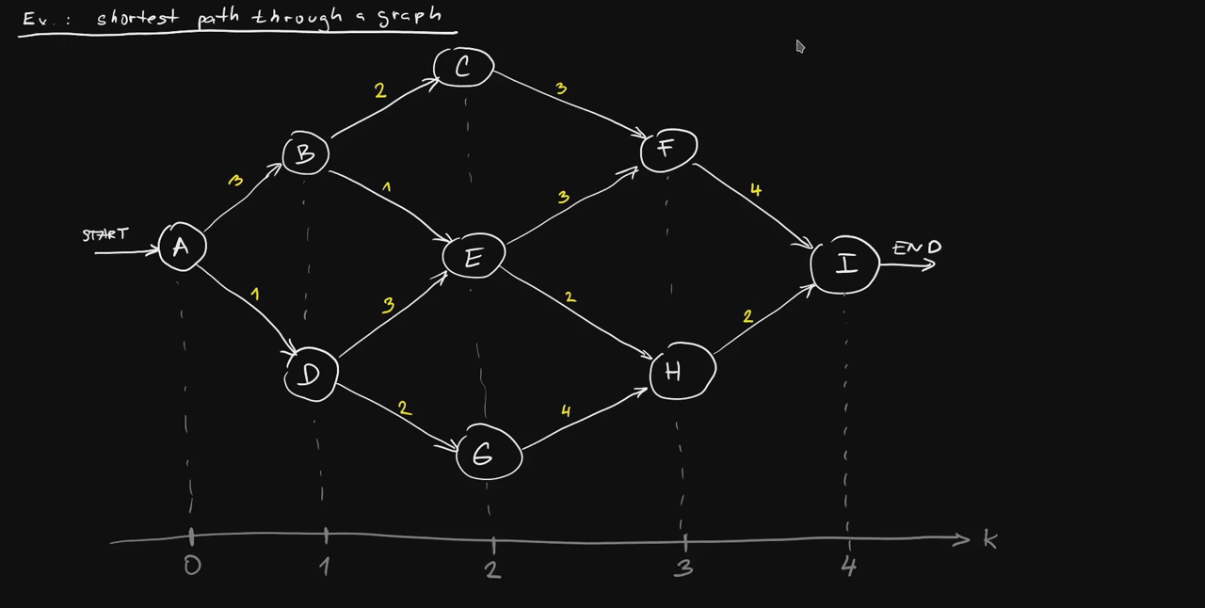
Shortest Path Problem using Dynamic Programming

Slide 25
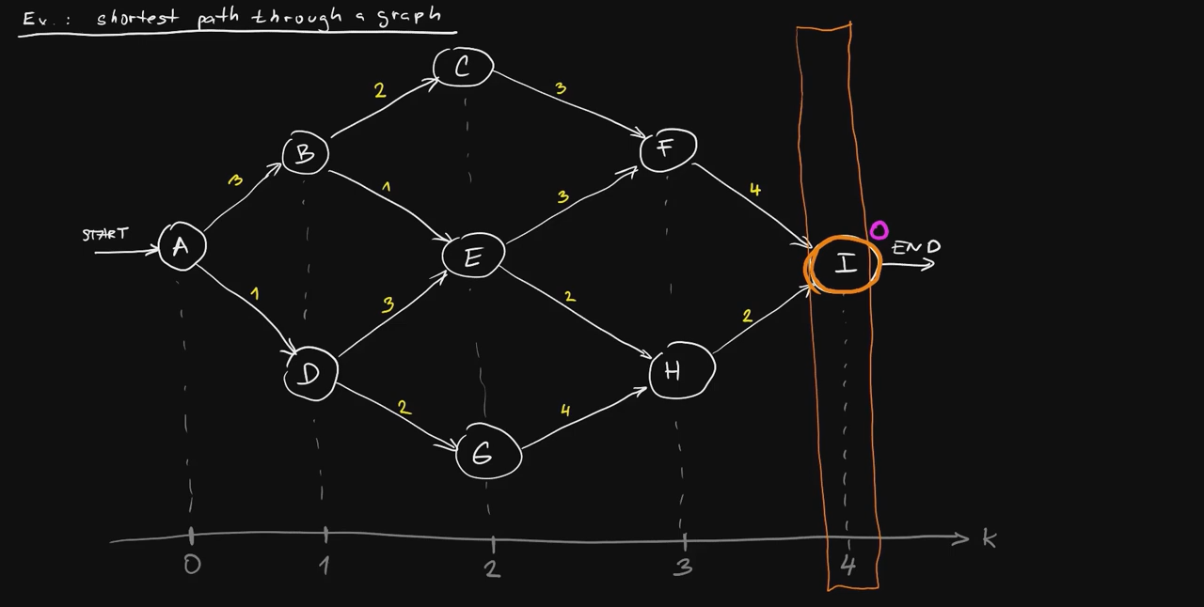

Slide 26
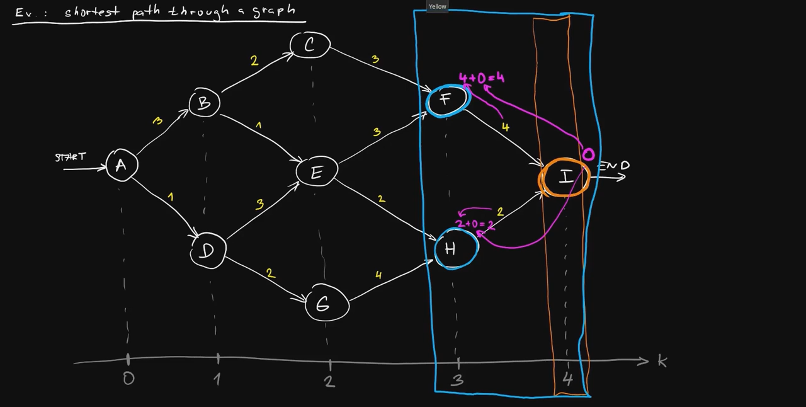

Slide 27
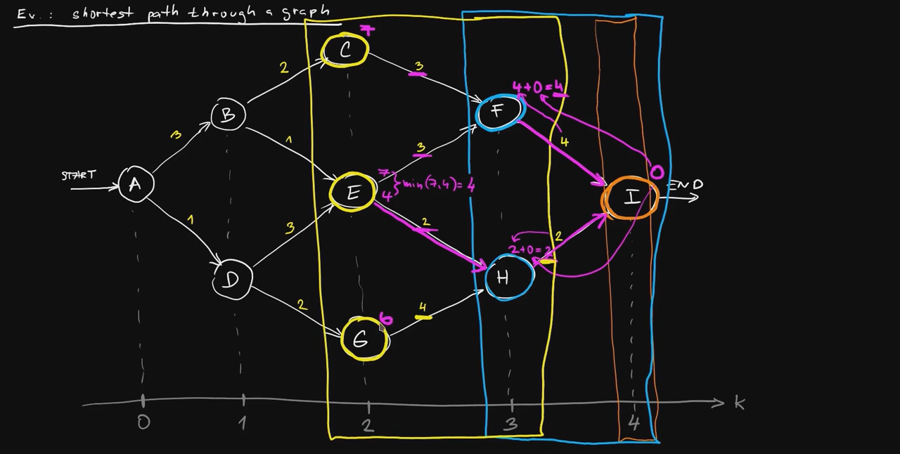

Slide 28
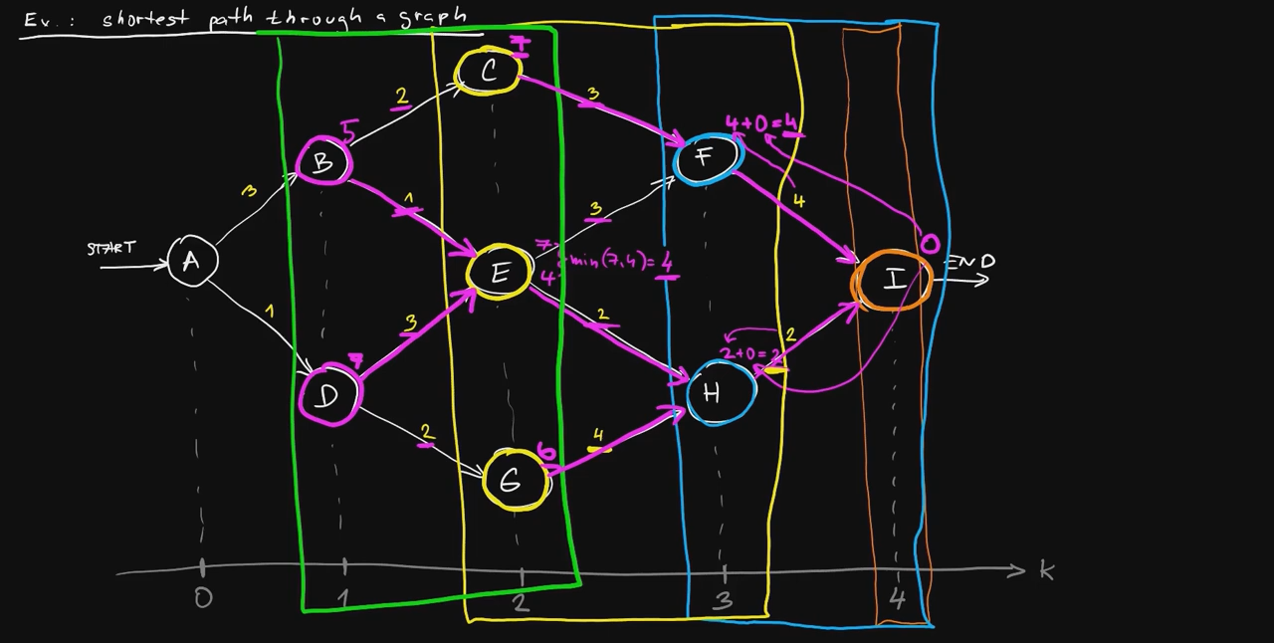

Slide 29
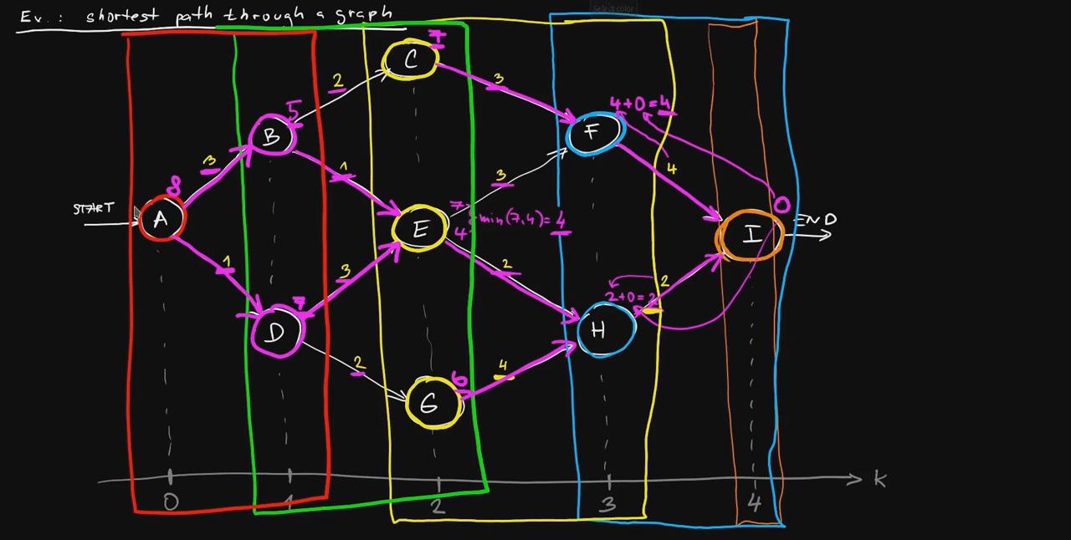

Slide 30
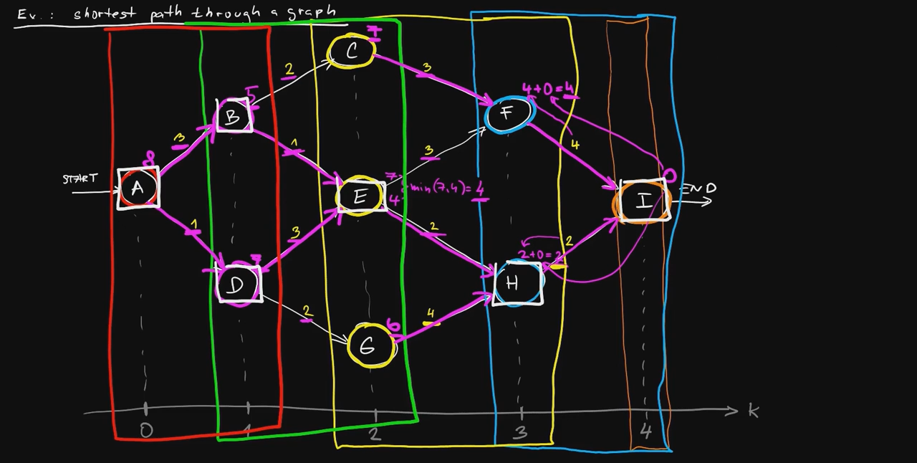

Slide 31
Do we even need a dynamic programming formulation in Power Systems?
Instead of using dynamic programming and optimization on
N state variables (including memory elements like Battery SOC)
C constraints
- All for T time steps
Why not just form:
N*T state variables (including Battery SOC)
C*T constraints plus T additional constraints to maintain continuity for those memory elements. (Let’s assume just one battery in our whole grid)
All into one big ‘steady-state-like’ Optimization problem and plug it into a solver?

Slide 32
Do we even need a dynamic programming formulation in Power Systems?
Instead of using dynamic programming and optimization, why not just incorporate more state variables, more constraints (both by a factor of the number of time-steps: T) into one big ‘steady-state-like’ Optimization problem and plug it into a solver?
I do not have an answer for this now, I’d imagine that the time complexity will increase exponentially, but that’s just my speculation.

Slide 33
Approximate Dynamic Programming

Slide 34
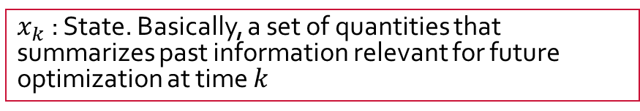
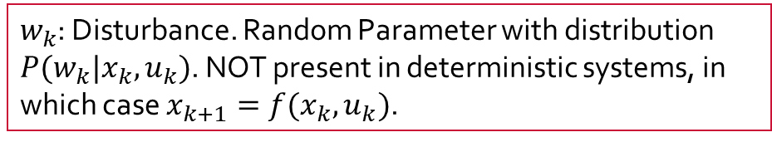
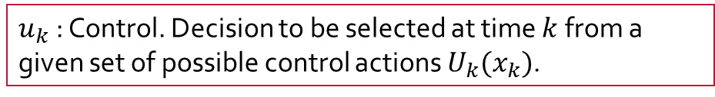
Basic Problem Structure of DP: Discrete-time System
$x_{k}$ : State. Basically, a set of quantities that summarizes past information relevant for future optimization at time $k$
$w_{k}$: Disturbance. Random Parameter with distribution $P(w_{k}|x_{k}, u_{k})$. NOT present in deterministic systems, in which case $x_{k+1}=f(x_{k}, u_{k})$.
$u_{k}$ : Control. Decision to be selected at time $k$ from a given set of possible control actions $U_{k}(x_{k})$.

Slide 35

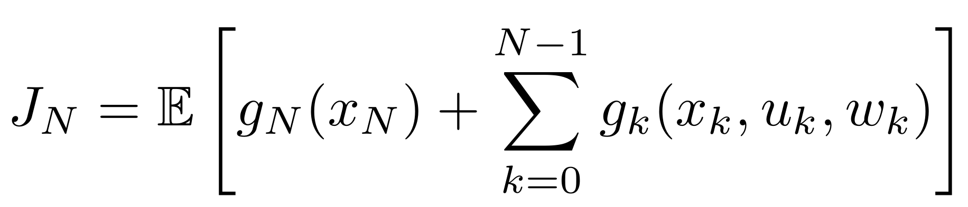
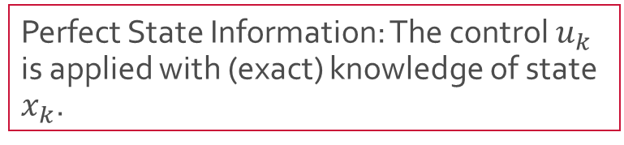
Basic Problem Structure of DP – Cost Function that is Additive over time
Perfect State Information: The control $u_{k}$ is applied with (exact) knowledge of state $x_{k}$.
The cost function uses Expectation operator as the system is (could be) stochastic.

Slide 36
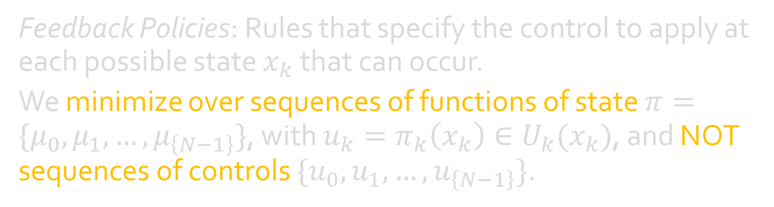
Optimization over Feedback Policies
Feedback Policies: Rules that specify the control to apply at each possible state $x_{k}$ that can occur.
We minimize over sequences of functions of state $π=\{μ_{0}, μ_{1},…, μ_{\left\{N−1\right\}}\}$, with $u_{k}=π_{k}\left(x_{k}\right)∈U_{k}(x_{k})$, and NOT sequences of controls $\{u_{0}, u_{1}, …, u_{\left\{N−1\right\}}\}$.

Slide 37
References (not in order)
CTU Prague Optimal and Robust Control - L5.1 - Introduction to dynamic programming and its application to discrete-time optimal control
The Julia Programming Language - Dynamic Programming and Seam Carving | MIT Computational Thinking Spring 2021 | Lecture 6
Hu et al. (2016) - A Dynamic Programming based method for optimizing power system restoration with high wind power penetration
Guerrero, Heydt et al (2008) - Optimal Restoration of Distribution Systems Using Dynamic Programming
Anamika Dubey, Surya Santoso (2015) - Electric Vehicle Charging on Residential Distribution Systems: Impacts and Mitigations
freeCodeCamp.org - Dynamic Programming - Learn to Solve Algorithmic Problems & Coding Challenges
Johan Driesen et al (KU Leuven, 2009) - The Impact of Charging Plug-In Hybrid Electric Vehicles on a Residential Distribution Grid

